Slide 1
Validation of Damen Installability Pipe routing tool

Slide 2
Built around cost function
$$c\left(n→n^{′}\right)=w_{dist}+w_{bend}⋅δbend+w_{vert}⋅δ_{vert}+w_{inst}⋅\left(1−s_{inst}\left(n^{′}\right)\right)−w_{tray}⋅δ_{tray}$$
Weights allow for fine tuning
Weight allow for vefication of cost function

Slide 3
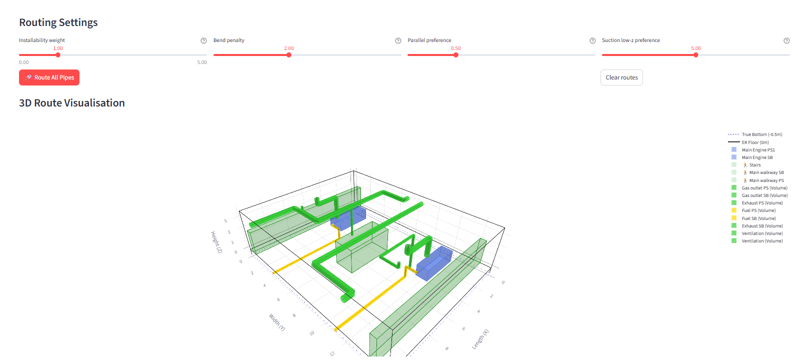
Adjusting installability dominance
Adjusting this shows effects of implementing the novel “installability” fuzzy logic

Slide 4
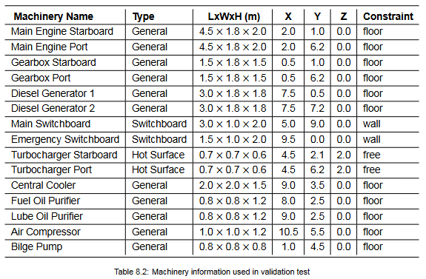
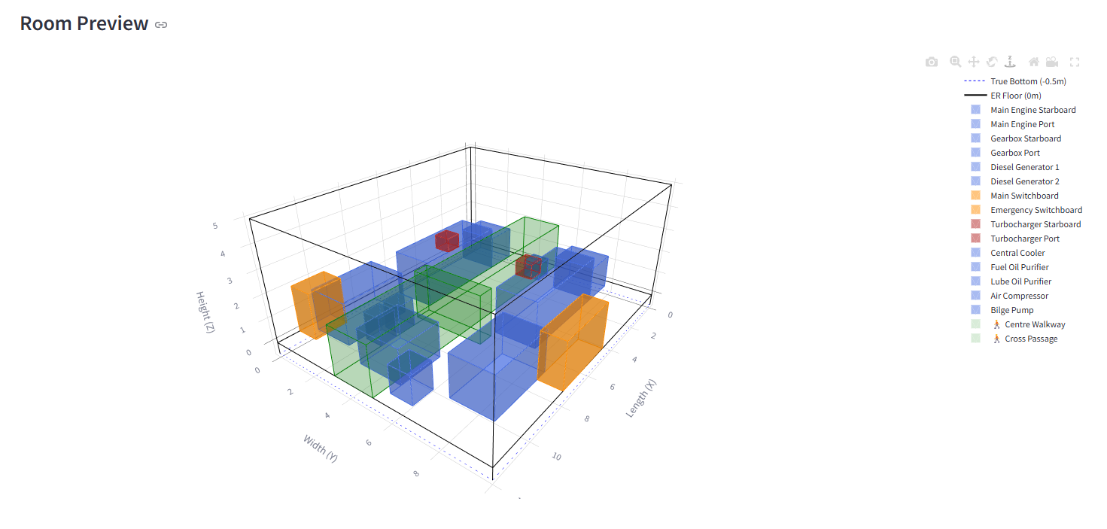
Input
Based on a fictional average engine room equipment layout.

Slide 5

Outputs: Example for $w_{inst}= 0.0$
 | Pipe | ⌀ (mm) | Priority | Length (m) | Install score | Time mult | Waypoints
0 | ME STB HP Fuel Supply | 32 | 1 | 10 | 0.992 | 0.94× | 101
1 | ME PORT HP Fuel Supply | 32 | 1 | 10 | 0.992 | 0.94× | 101
2 | ME STB Jacket Cooling | 80 | 2 | 11.5 | 0.94 | 1.10× | 116
3 | ME PORT Jacket Cooling | 80 | 2 | 8.9 | 0.913 | 1.18× | 90
4 | Sea Water Cooling Main | 100 | 2 | 8.1 | 0.868 | 1.32× | 82
5 | Fire Main | 80 | 2 | 10.4 | 0.99 | 0.94× | 105
6 | Starting Air STB | 40 | 2 | 12.6 | 0.895 | 1.24× | 127
7 | DG1 Fuel Supply | 25 | 3 | 4.6 | 0.906 | 1.20× | 47
8 | DG2 Fuel Supply | 25 | 3 | 3.3 | 0.942 | 1.09× | 34
9 | Ballast Main | 100 | 3 | 17.6 | 0.92 | 1.16× | 177
10 | Starting Air PORT | 40 | 3 | 9.8 | 0.871 | 1.31× | 99
11 | Bilge Main Discharge | 80 | 4 | 7.9 | 0.916 | 1.17× | 80
12 | Bilge STB Collection | 65 | 5 | 16.1 | 0.976 | 0.98× | 162
13 | Bilge PORT Collection | 65 | 5 | 15.1 | 0.982 | 0.96× | 152
14 | Fuel Oil Transfer | 50 | 5 | 5 | 1 | 0.91× | 51

Slide 6
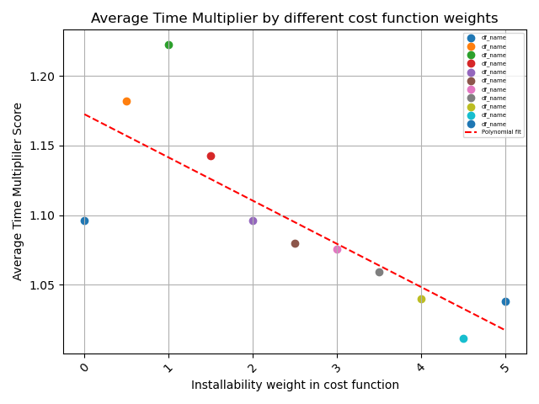
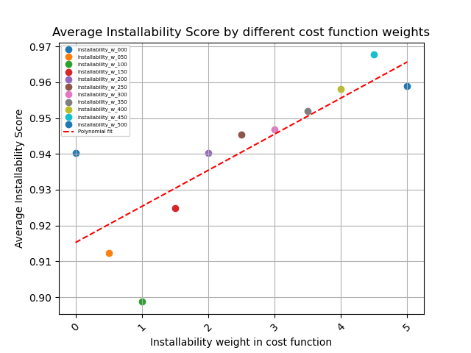
Averaged Install Score and TM
Install preference in cost function becomes dominant from 2 onwards.
Inverse peak explained next slide

Slide 7
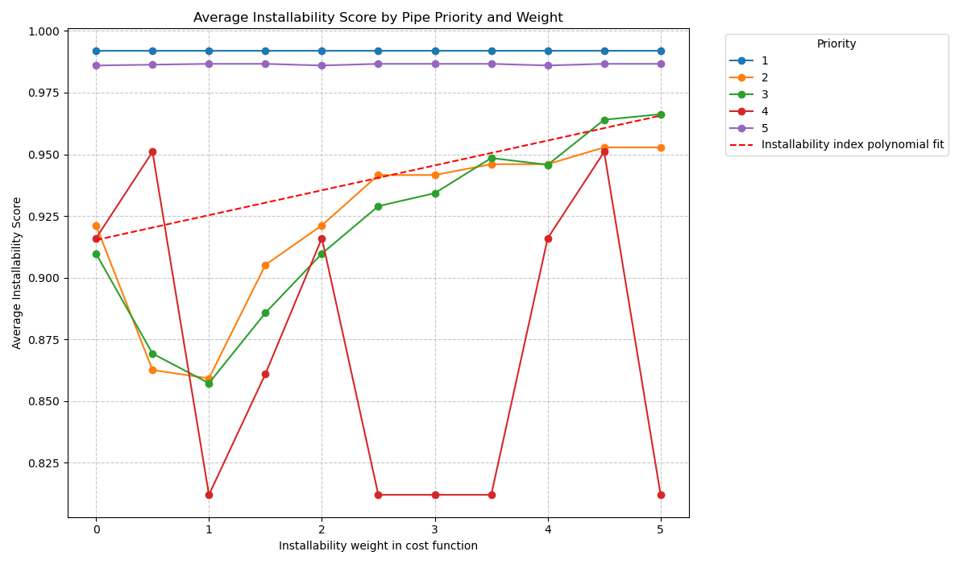
Initial descrepancy when increasing installability dominance
Install score only affected by mid-level priority pipes
High priority pipes take high clearance space, mid-level pushed here due to shorter routing dominance

Slide 8
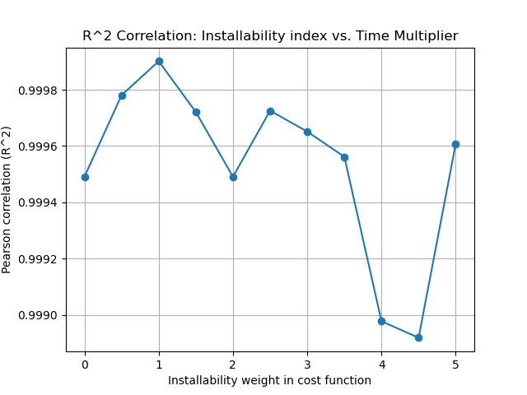
Relation Install score & time multiplier
Extreme linear correlation: Pearson r = -0.9995.
Near perfect inverse linear correlation
Explicable as follows:
2 inputs from engineers, describing install ease phenomenon
Demonstrates the internal consistency of 9 questioned experts

